Slide 1
STOCK MARKET INVESTMENT PLATFORM
Name: Magapalli Pawan Kumar

Slide 2
ABSTRACT
Stock Market Investment Platforms are vital tools for investors to:
Track investments and manage portfolios efficiently.
Access real-time stock market data and trends.
Make informed decisions based on market performance.
The increasing complexity of financial markets requires investors to stay updated with:
Market fluctuations.
Portfolio value changes.
Stock performance and news.

Slide 3
ABSTRACT
Benefits of Using a Stock Market App:
Provides a user-friendly interface for tracking and analyzing investments.
Enables real-time monitoring of stocks, Mutual Fudss, and other securities.
Assists in portfolio management by organizing assets and investment goals.
Offers alerts, notifications, and insights into market movements.
Why this Platform is Unique:
A personalized approach to portfolio management.
Integration of market data with analysis tools for making data-driven investment decisions.
Future features like customized dashboards, real-time stock tracking, and portfolio optimization.

Slide 4
System Analysis
EXISTING SYSTEM :
Limited Personalization:
Most platforms offer generic dashboards with minimal customization options.
Users cannot tailor the dashboard to their specific investment needs or goal
2. Static Portfolio Tracking:
Users are often required to manually input portfolio data.
Real-time portfolio updates based on live market data are not available unless integrated with brokerages.

Slide 5
System Analysis
EXISTING SYSTEM :
3. Delayed Market Data:
Free users of platforms like Yahoo Finance and Google Finance experience data delays, sometimes by several minutes.
This delay can affect the decision-making process in fast-moving markets.
4. Lack of Educational Resources:
Existing platforms, such as Bloomberg, cater mainly to advanced users, leaving novice investors without the necessary guidance and educational resources.
Users have to rely on external resources to learn about stock market basics and investment strategies.

Slide 6
System Analysis
PROPOSED SYSTEM :
Enhanced Personalization:
Users will have the ability to create customized dashboards with sector-specific data, real-time stock charts, and performance analytics tailored to their personal financial goals.
Personalized recommendations based on the user’s portfolio and investment strategy will be provided.
2. Real-Time Portfolio Tracking:
The proposed platform will integrate directly with brokerage accounts, allowing for real-time portfolio updates without the need for manual data entry.
Users can see live changes in their investments as market prices fluctuate.

Slide 7
System Analysis
PROPOSED SYSTEM :
3. Real-Time Market Data:
The platform will provide real-time stock market data without delays, ensuring users can make time-sensitive decisions.
Accurate real-time tracking of stock prices, market trends, and performance metrics will be prioritized.
4. Educational Support for Novices:
A major advantage of the proposed system will be beginner-friendly educational content, including tutorials on how the stock market works, investment strategies, and risk management.
The platform will have built-in tools to help novice investors understand market trends and make more informed decisions.

Slide 8
SUMMARY
Existing System platforms, while offering basic stock market tracking and portfolio management, fall short in areas like personalization, real-time updates, educational support, security, and real-time alerts.
Proposed System offers significant improvements by addressing these shortcomings with features such as real-time integration, advanced customization, enhanced security, and beginner-friendly educational resources, positioning it as a superior alternative for investors of all levels.

Slide 9
SYSTEM REQUIREMENTS
H/W System Configuration:-
Processor - i3 – 11th gen or Above
RAM - 4 GB (min)
Hard Disk - 20 GB
KeyBoard - Standard Windows Keyboard
Mouse - Two or Three Button Mouse
Monitor - SVGA
Software Requirements:
Operating System - Any Windows Family or Linux
Frontend - Html,Css , Javascript and ReactJS
Backend - Java,SpringBoot
DataBase - mongoDB
Browser - Any Browser With Dev Tools

Slide 10
MILESTONE – 1 Module 1: User Authentication and Registration
Component-based Architecture:
1. Login Component:
Created a Login component that includes form fields for username and password.
Used React's useState and useRef hooks to manage input values and validation logic.
Integrated form validation to ensure users provide correct input before submission (e.g., minimum 8 characters, alphanumeric password).

Slide 11
Module 1: User Authentication and Registration
Component-based Architecture:
2. Registration Component
Developed the Registration component with form fields such as Name, Email, and Password.
Included input validation to check for valid email format and password complexity.
Implemented form feedback messages using conditional rendering (success or error messages).
3 .State Management:
Managed form state using the useState hook.
Controlled inputs by linking form fields to React's state to allow dynamic updates and validation.

Slide 12
Module 1: User Authentication and Registration
Form Submission:
Handled form submission with an onSubmit function that verifies input, triggers validation.
5. UI Design:
CSS for Styling:
Created a clean and responsive layout using CSS and Flexbox/Grid layouts.
Styled input fields, buttons, and error messages for better user experience.
Aligned the "Login" button centrally with distinct styling (blue color, etc.).
Responsive Design:
Ensured the UI works seamlessly across different screen sizes (using media queries).

Slide 13
Module 1: User Authentication and Registration
6. Password Validation:
Implemented custom password validation logic to ensure passwords meet criteria:
Minimum 8 characters.
Alphanumeric validation (mix of letters and numbers).
Added real-time feedback for password strength.
7. Error Handling:
Handled invalid login attempts or incorrect registration details by providing user-friendly error messages.
Included form validation that prevents submission until the correct details are provided.

Slide 14
MILESTONE – 1 Module 1: User Authentication and Registration
8. Popup Notifications:
Implemented feedback messages that pop up on successful login or registration, or when there's an error.
Used CSS for smooth transitions and positioning of these notifications.
9. React Router for Navigation:
Used React Router to manage page transitions for login, registration, and other routes.
Provided navigation between the login, registration, and dashboard pages.

Slide 15
MILESTONE – 1 Module 1: User Authentication and Registration
10. React Icon:
Added the React icons to the Login and Registration Page .
Styled the icon using CSS to ensure it fits well with the layout and can be aligned or repositioned as needed.
Used the react-icons library to import the React icon and other related icons for UI elements.
Applied styling to ensure the icon moves or adjusts according to the screen size or layout requirements.

Slide 16
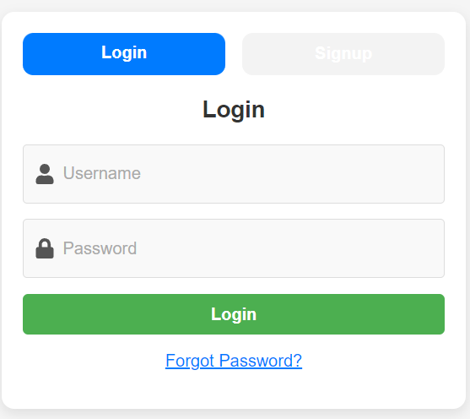
MILESTONE – 1 Module 1: User Authentication and Registration
LOGIN.JSX

Slide 17
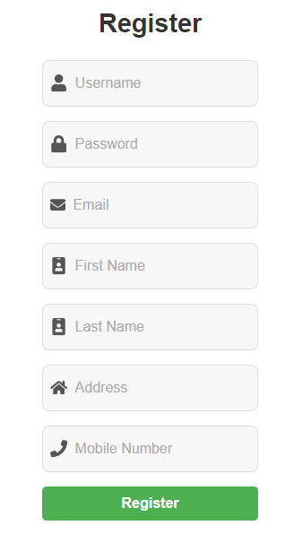
MILESTONE – 1 Module 1: User Authentication and Registration
REGISTRATION.JSX

Slide 18
MILESTONE – 1 Module 4: DASHBOARD
Key Features of the Dashboard :
User Profile: Displays name and avatar for a personalized experience.
Trending Cryptocurrencies:
Shows popular cryptocurrencies and price updates.
Icons for quick visual reference.
Trending Stocks:
Lists key stocks with current prices.
Helps users track important stocks at a glance.
Latest News:
Provides recent market news with images and summaries.
Users can access full articles for detailed insights.

Slide 19
DASHBOARD
Benefits to Users:
Centralized Access: All key information in one view.
Real-Time Data: Quick updates for informed decision-making.
User-Friendly Design: Easy to navigate, personalized dashboard.
Future Enhancements:
Portfolio Analytics: In-depth insights on user portfolio performance.
Real-Time Notifications: Alerts for stock or crypto movements.
Interactive Data Visualizations: Charts for better data interpretation.

Slide 20
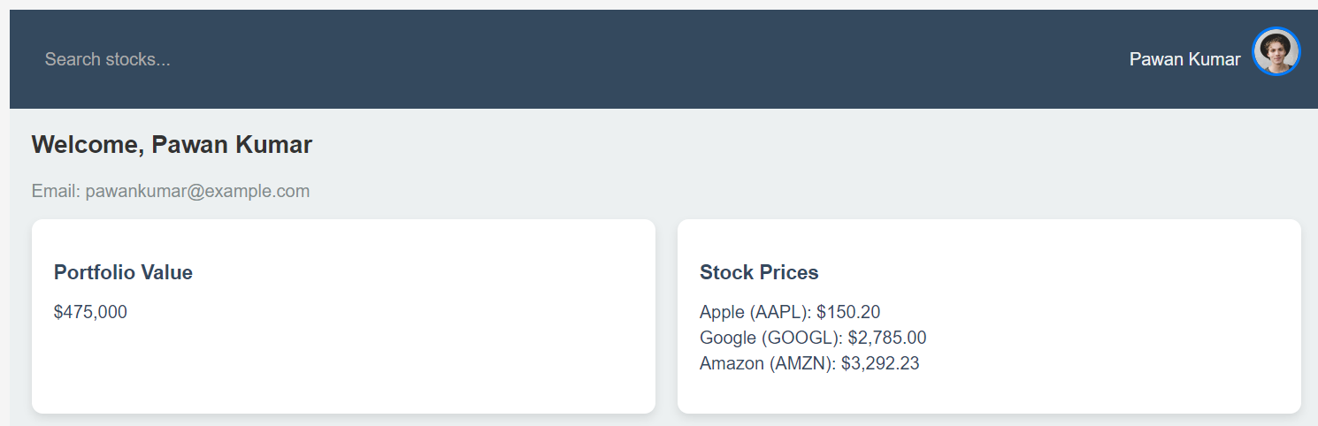
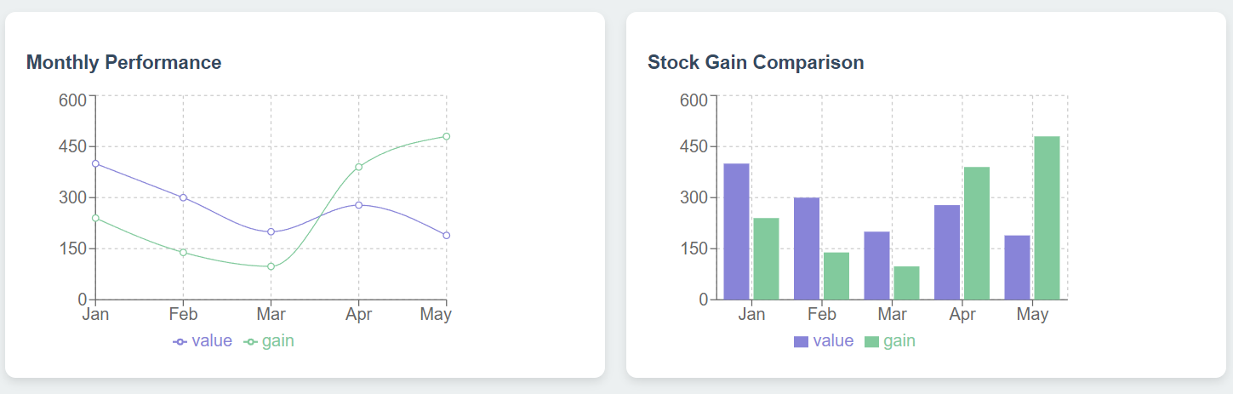
DASHBOARD

Slide 21
PORTFOLIO
Investment Tracking:
Allows users to monitor their stocks, cryptocurrencies, or other assets in one place.
Provides insights into individual asset performance over time.
Financial Planning:
Helps investors assess how their investments align with financial goals.
Assists in identifying profitable assets and underperformers.
Decision Making:
Empowers users with data to make informed buy/sell/hold decisions.
Enables risk management by showing portfolio diversification.

Slide 22
PORTFOLIO
Benefits of Using a Portfolio
Centralized Overview:
Users can see all their investments, including stock quantity, purchase prices, and current market value, in one interface.
Performance Metrics:
Offers detailed metrics like:
Overall portfolio value.
Gain/loss percentages.
Performance comparisons across assets.
Customization:
Allows users to add or remove stocks, set target prices, and track specific metrics.
Custom alerts for market fluctuations or performance goals.
Historical Data Analysis:
Tracks performance trends with historical charts, enabling better investment strategies.
Ease of Access:
Replaces manual tracking in spreadsheets with automated and real-time updates.

Slide 23
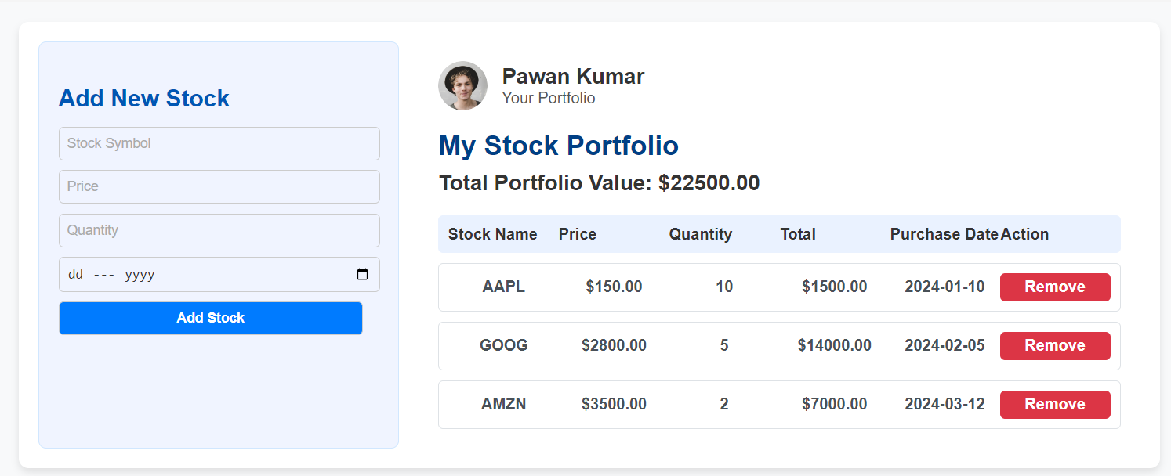
PORTFOLIO

Slide 24
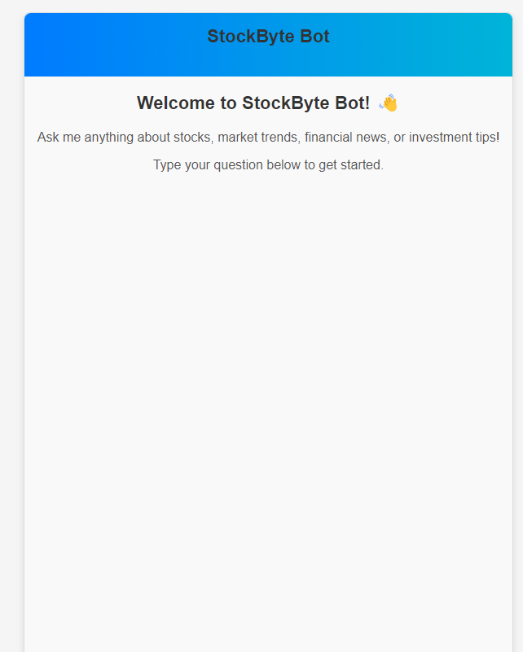
Help Center

Slide 25
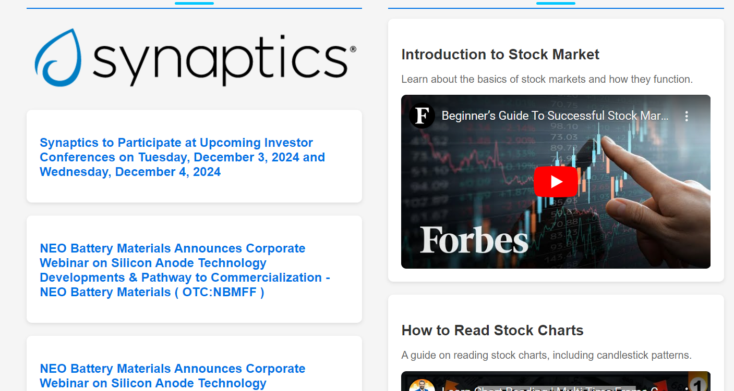
Education

Slide 26
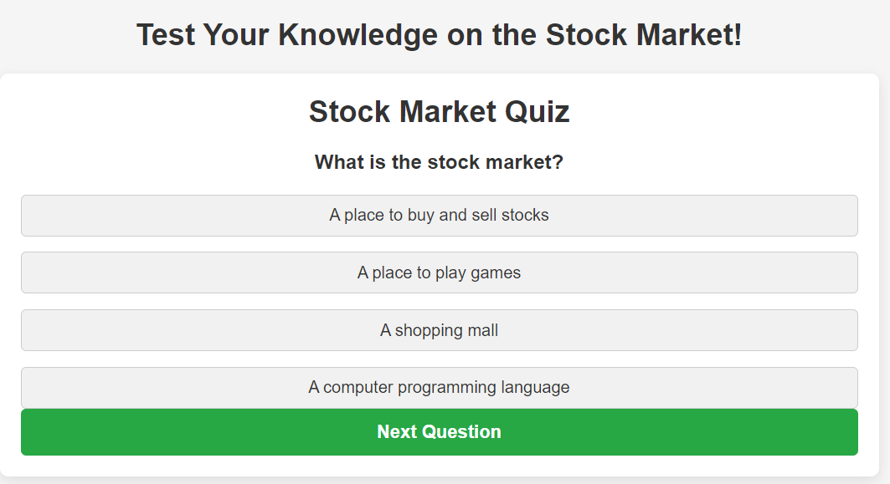
Quiz Section

